Slide 1

Saving money in difficult financial times

Slide 2
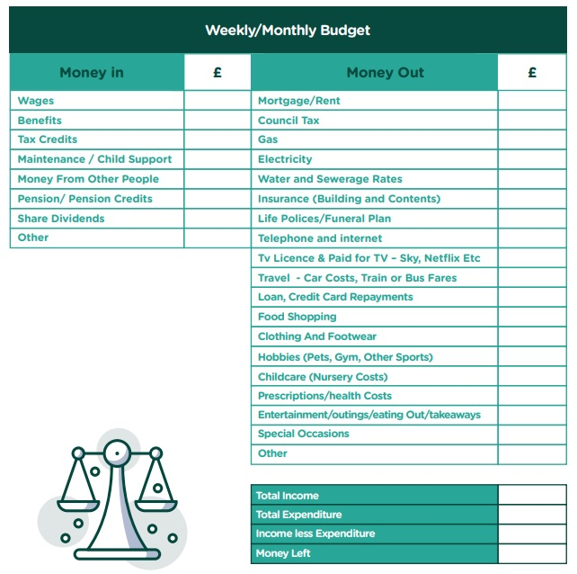
Budget – know the truth about your finances
Do an income and expenditure sheet and analyse your spending
Plan for future expenses in your budget – utility bill increases, Christmas, holidays, buffer fund
Will your bank account do this for you?
Download our free Wave Money Guide for this budget sheet and other resources

Slide 3

Utility bills – Gas & Electricity
Switch provider – you may be able to save money
Do regular meter readings to make sure you are paying the right amount
Check the app – what is your suggested direct debit? Switch as soon as you can to what you recommend you pay if you can afford it to stop arrears building
WHERE TO TURN IF YOU ARE IN ARREARS WITH FUEL BILLS
National Energy Action (NEA). The NEA is a national fuel poverty and energy efficiency charity. It provides energy advice to households in England and Wales. You can contact it on 0800 304 7159, or fill in an online form. It offers advice on income maximisation, energy billing, fuel debt, energy efficiency and trust fund applications.
LEAP (Local Energy Advice Partnership) – free service to help people keep warm and reduce energy bills with tailored advice and support. Eligibility for help is generally if income is less than £31k p.a. or if in receipt of benefits, credits or allowances.
Talk to Citizens Advice if you need help with fuel bill arrears

Slide 4

Utility bills
WATER - Southern Water and Southeast Water have social tariffs. There are criteria for them and discounts from 45-90%
BROADBAND - The companies offering social tariffs are BT, Now, Sky, Virgin Media, Vodafone, Hyperoptic, G Network, KCOM and CountryConnect.
COMBINING BILLS –telephony discounts – BT & EE
CONTRACTS – is your mobile or broadband contract up? Look for a better deal. Switch to SIM only if your phone contract is up.

Slide 5
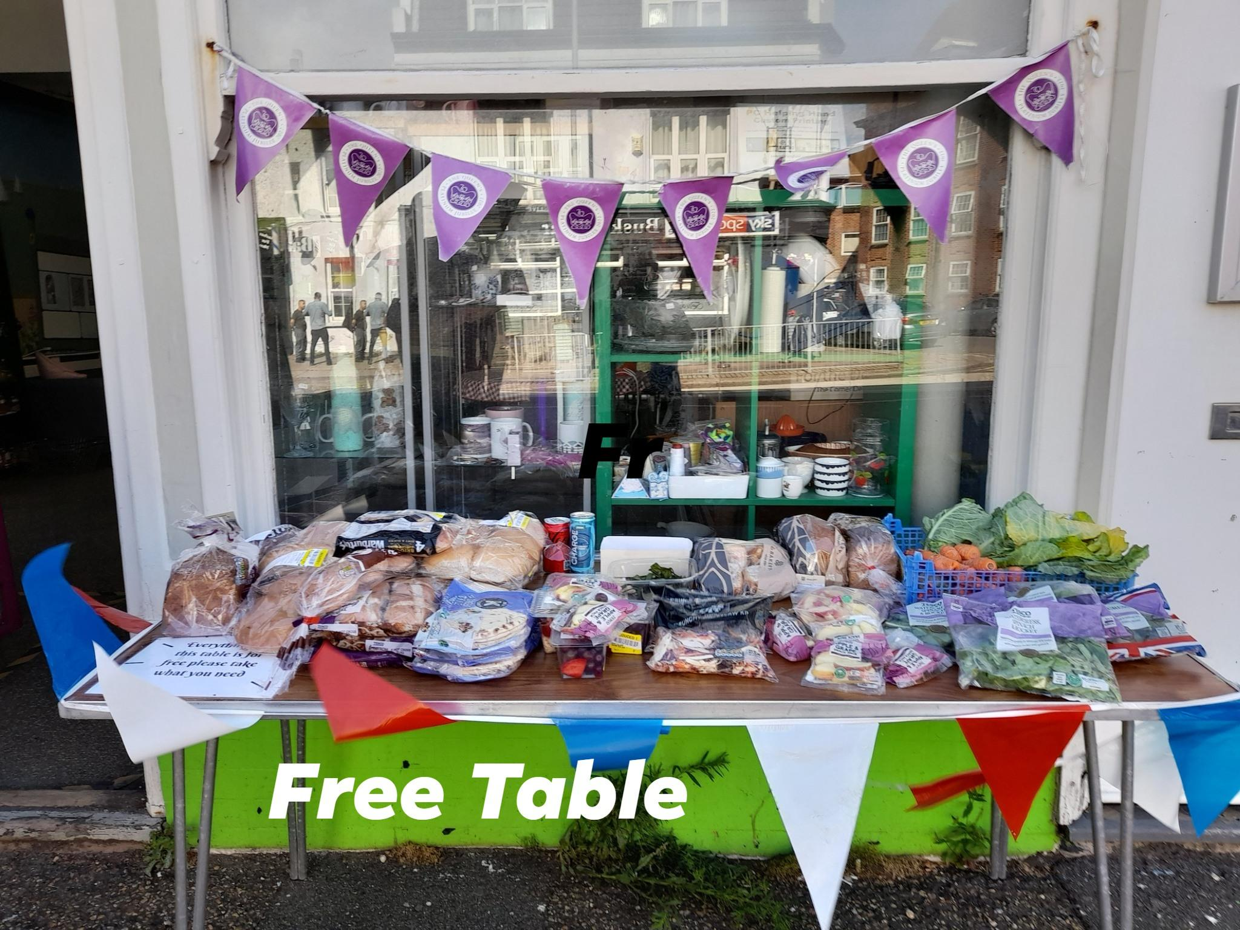
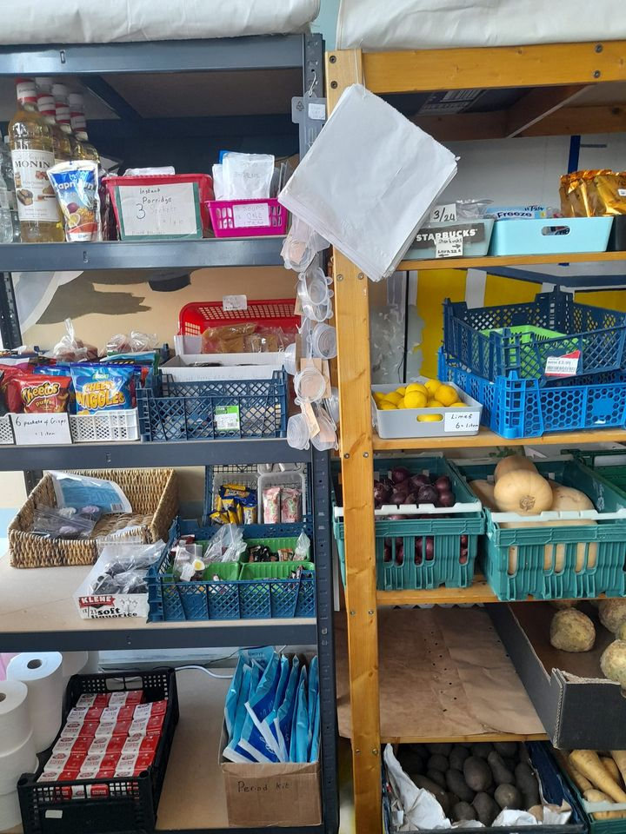
Food
Foodbanks – get a referral to access them
Community fridges or Community Pantries - weekly charges
Community Supermarkets with a Pay as You Feel Model
Community kitchens and cafes
Cooking at home – improve your skills with free cookery classes. Cheap meal menus online

Slide 6
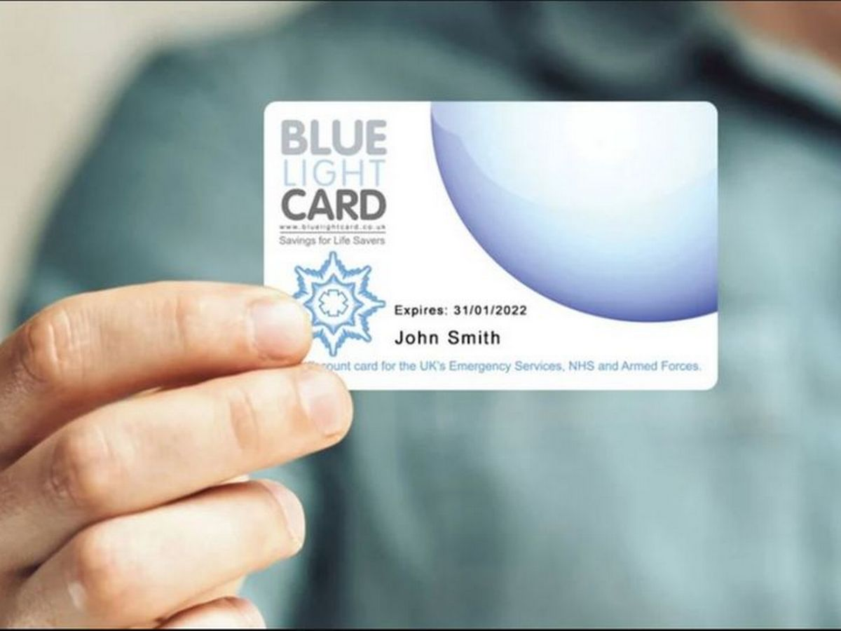
Make the most of staff benefits
Payroll lending– lower loan rates to members paying through payroll
Staff discount schemes – My Staff Shop and Reward Gateway are common ones
NHS - Blue Light card discounts – online & high street discounts. £4.99 for 2 years access. NHS England webpage with staff discounts
Uniform tax refund – If you have to wash or repair your uniform yourself, you may be able to claim tax relief, which could be £100s. The standard flat-rate expense allowance for uniform maintenance is £60 – though many working in the NHS are entitled to more
Working from home – claim £6 per month from HMRC

Slide 7

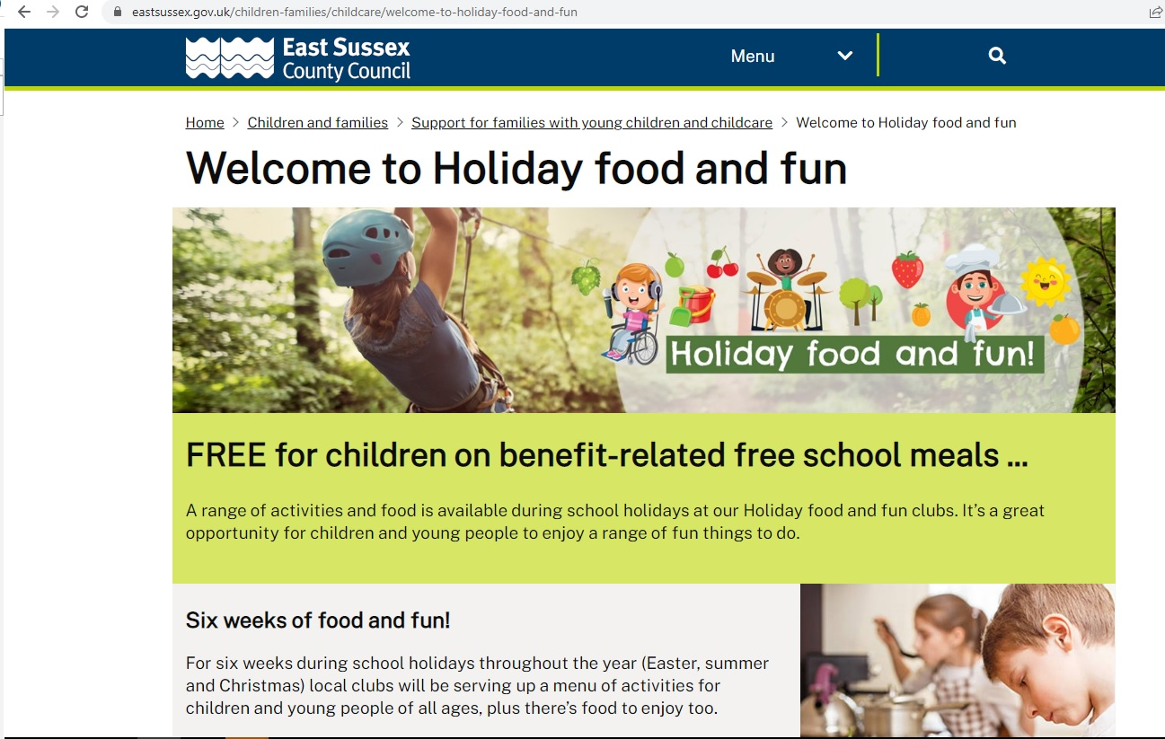
School costs
Uniforms – second hand sales /giveaways through the PTA or visit Smarter Uniforms (smarteruniforms.org) for B&H schools
Free School Meals – apply for these via gov.uk website: https://www.gov.uk/apply-free-school-meals.
School holidays – Holiday Food and Fun. Free activities in Easter, Summer and Winter holidays for those on FSM organised by local councils
School trips – if you can’t afford the costs of school trips speak to the school. Schools & PTAs often sponsor children to go on these trips.

Slide 8

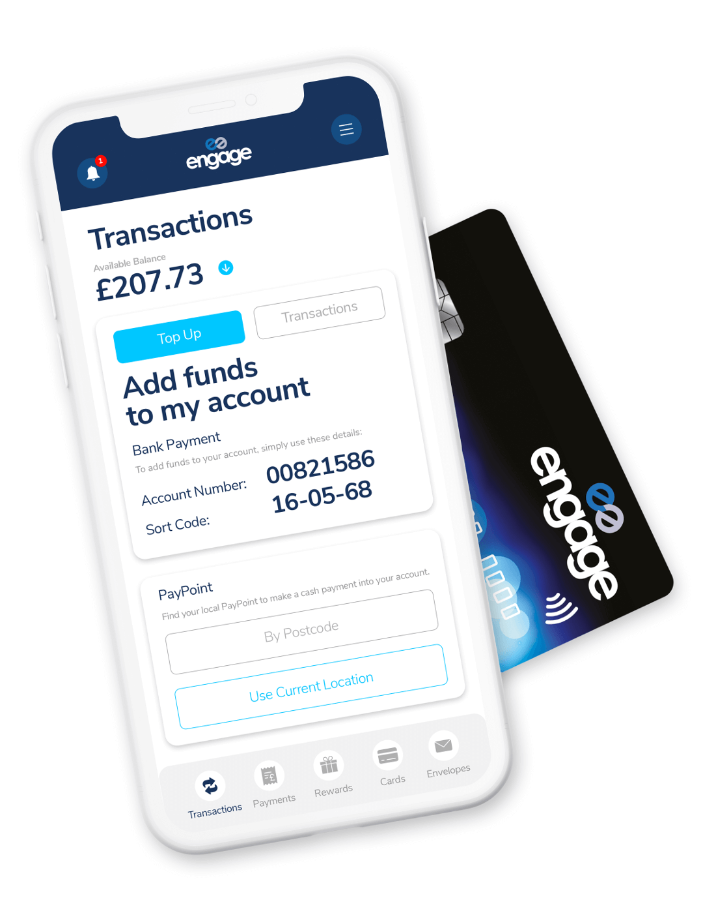
Save on financial services
Shop around when it’s time to renew
  Household – buildings & contents
  Car insurance & recovery
  Holiday
  Does your bank account include insurances or breakdown recovery?
  Mortgage
    Fixed rate period coming to an end? How early can you change to a new deal?
    Get advice
  Switch bank accounts
    Some give up to £200 incentive to switching – check on Money Saving Expert
    Accounts with cash back and rewards - Engage

Slide 9



Maximise your income: know what you are entitled to
Benefits calculators – find out what benefits you might be entitled to. WCB website or Turn 2 Us
www.wavecb.org.uk/benefits-calculator/
MoneyHelper – content on WCB website with hints and tips on saving money, budget calculator and where to find debt advice locally
Moneyworks in Brighton & Hove call: 0800 988 7037 (open Mon 2.30-4.30, Tue 9.30-11.30, Wed 11-1 & Thu 2.30-4.30, and Fri 10-12)
Elsewhere talk to Citizens Advice

Slide 10



Where to go for help with debt
Step Change – a full debt help service available across the UK. Online advice available via its debt advice tool, where you can create a budget and get a personal action plan with practical next steps.
Citizens Advice – full debt and consumer advice service. Many CAs have specialist caseworkers to deal with any type of debt, including repossessions and negotiation with creditors.
National debt line – provides free advice and resources to help people deal with their debts. Advice is available over the phone, online and via webchat.
MoneyWorks in Brighton & Hove

Slide 11

Get online to keep up to date
Subscribe to newsletters with offers and advice – let other people do the hard work for you
Money Saving Expert
Money Magpie
Quids In Reader Club
Skint Dad
Voucher sites – groupon etc
Local Council Cost of Living Support page
Follow WCB on social media – we share hints and tips for saving money regularly

Slide 12
Services Wave Community Bank offer

Slide 13


Savings accounts
Savings accounts to help build financial resilience
SHARE ACCOUNT – up to four share accounts
WAVE SAVE – set savings goals and targets
PRIZESAVER – save and be entered into a monthly draw for £5000
Same day withdrawals from all accounts – when requested before 3pm
We don’t pay interest. We pay a dividend on savings if we make a large enough profit
Set up regular savings via standing order or payroll deduction

Slide 14


Affordable loans
Loans from £500- £35,000 from 5%APR
Loans are issued for all sorts of reasons – we won’t lend to pay a loan shark though
We report to CRAs so borrowers can build credit scores with us
All loans have a savings element to build financial resilience
No early repayment fees or penalties
We lend to people on benefits Repayment options:
  Direct debit
  Payroll if working for an employer partner
  Child Benefit for Family Saver Loans

Slide 15
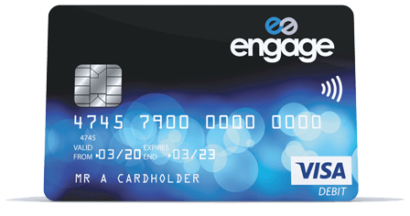
Basic bank accounts
Engage is a prepaid VISA account
No credit check required
Credit union exclusive account – must be a member to apply for Engage
Cashback and rewards
£2 pcm fee plus fees for using ATM. Free to use in store and online
Account can be used to receive benefits and wages
Mobile app, telephone and online support
Sign up using the Engage app – need to be a WCB member and have a promo code from us to open account

Slide 16




Chorus Workplace Savings Scheme
Save and repay loans with us straight through your wages
WCB has partners across East Sussex and Kent including
Local authorities – KCC, ABC, MBC, BHCC, ESCC, LDC, EBC
NHS Trusts – University Hospitals Sussex, East Sussex Healthcare and Sussex Community
Transport - Brighton & Hove Buses, Metrobus, The Big Lemon, Community Transport Brighton & Hove
Charities – BHT Sussex, Amaze, 3VA, Grace Eyre
Private businesses – Let’s Do Business, Michelmersh Bricks, Tsurumi Pumps UK
Education establishments – University of Brighton, Varndean School

Slide 17
Q&A
Thanks for joining us www.wavecb.org.uk

