Slide 1
Financial Wellbeing
Kent & East Sussex
Claudine Bell
South East Regional Partnerships Manager
Claudine.bell@maps.org.uk

Slide 2
Agenda for today
Credentials – who we are and what we do
Financial wellbeing – what does this mean?
4 Steps to Financial Wellbeing with Money Helper
Questions

Slide 3





Who we are
    An executive non-departmental public body sponsored by the Department for Work and Pensions (DWP) with whom we also work on pensions policy.
    We work with HM Treasury on policy matters relating to financial capability and debt advice.
    Formed by the Financial Guidance and Claims Act 2018 that established a new single financial guidance body.
    Majority of our funding comes from the Financial Conduct Authority (FCA) from the levies they collect.
Financial Guidance
and Claims Act
Notes:
We are The Money and Pensions Service (MaPS) and we exist to help people make the most of their money and pensions. We were created under the Financial Guidance and Claims Act 2018.
We are an arm’s-length body sponsored by the Department for Work and Pensions (DWP), with a commitment to provide access to the information and guidance people across the UK need, to make effective financial decisions over their lifetime. We also engage with the Treasury on policy matters relating to financial capability and debt advice.
We are responsible for improving financial well being and helping everyone to make the most of their money and pensions
We are Independent and impartial and our service is free. We highlight this so you can feel confident that our resources are trustworthy

Slide 4


        Financial wellbeing
Mental wellbeing
Financial wellbeing is about feeling secure and in control. It is about making the most of your money day to day, dealing with the unexpected, and being on track for a healthy financial future. In short: financially resilient, confident and empowered.
Mental health is not just the absence of mental disorder. It is defined as a state of well-being in which every individual realises his or her own potential, can cope with the normal stresses of life, can work productively and fruitfully, and is able to make a contribution to her or his community.
Money problem
Mental Health problem
Notes:
We have a definition for financial well being and this is it……
…
We know that mental and financial wellbeing are inexriciably linked.
If your mental wellbeing is suffering it can affect the way you deal with money. If you're feeling low or depressed, you may lack motivation to manage your finances. You might avoid doing things to stay on top of your money, like opening bills or checking your bank account.
If your mental health is suffering you might make impulsive financial decisions like spending to make yourself feel better and your ability to work could be affected,
Similarly, people with problem debt are significantly more likely to experience mental health problems and an unstable financial situation can also cause mental distress.

Slide 5

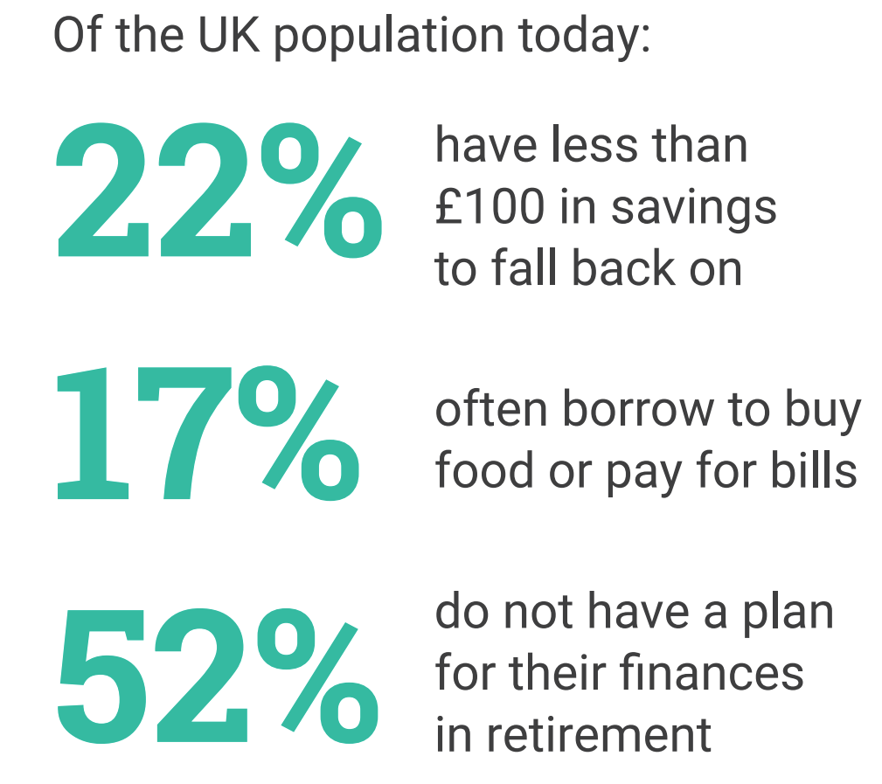
With many grappling with cost-of-living pressures and the challenges of managing their money in uncertain times, it is no surprise that 19 million people in the UK feel worried when thinking about their financial situation.
Notes:
I don’t need to tell you that things are tough out there and as a result financial and mental wellbeing are being impacted.
As part of its Financial Lives survey, the FCA found that the cost of living is having an impact on people’s mental wellbeing. Around half of UK adults, or 28.4 million people, in January 2023 felt more anxious or stressed due to the rising cost of living than six months earlier.
The South East of England has more homeowners via a Mortgage than any other region in England. Figures from the regulator the Financial Conduct Authority show that around 1.5 million homeowners will come to the end of fixed-rate mortgage deals during 2024. And the Bank of England has estimated around five million homeowners will see their monthly mortgage payments rise between now and 2026. This will of course have an impact on rental rates too. Coupled with higher food prices and energy bills the rising cost of living is something that many people will not be able to escape.
Therefore you need to be able to know how to manage your money effectively and where to turn for support guidance and help

Slide 6

MoneyHelper – free, impartial, unbiased support, Information and guidance.
https://www.moneyhelper.org.uk/en
Notes:
Money Helper is our customer facing website and we like to say it has information from pocket money to pensions and everything in between.

Slide 7
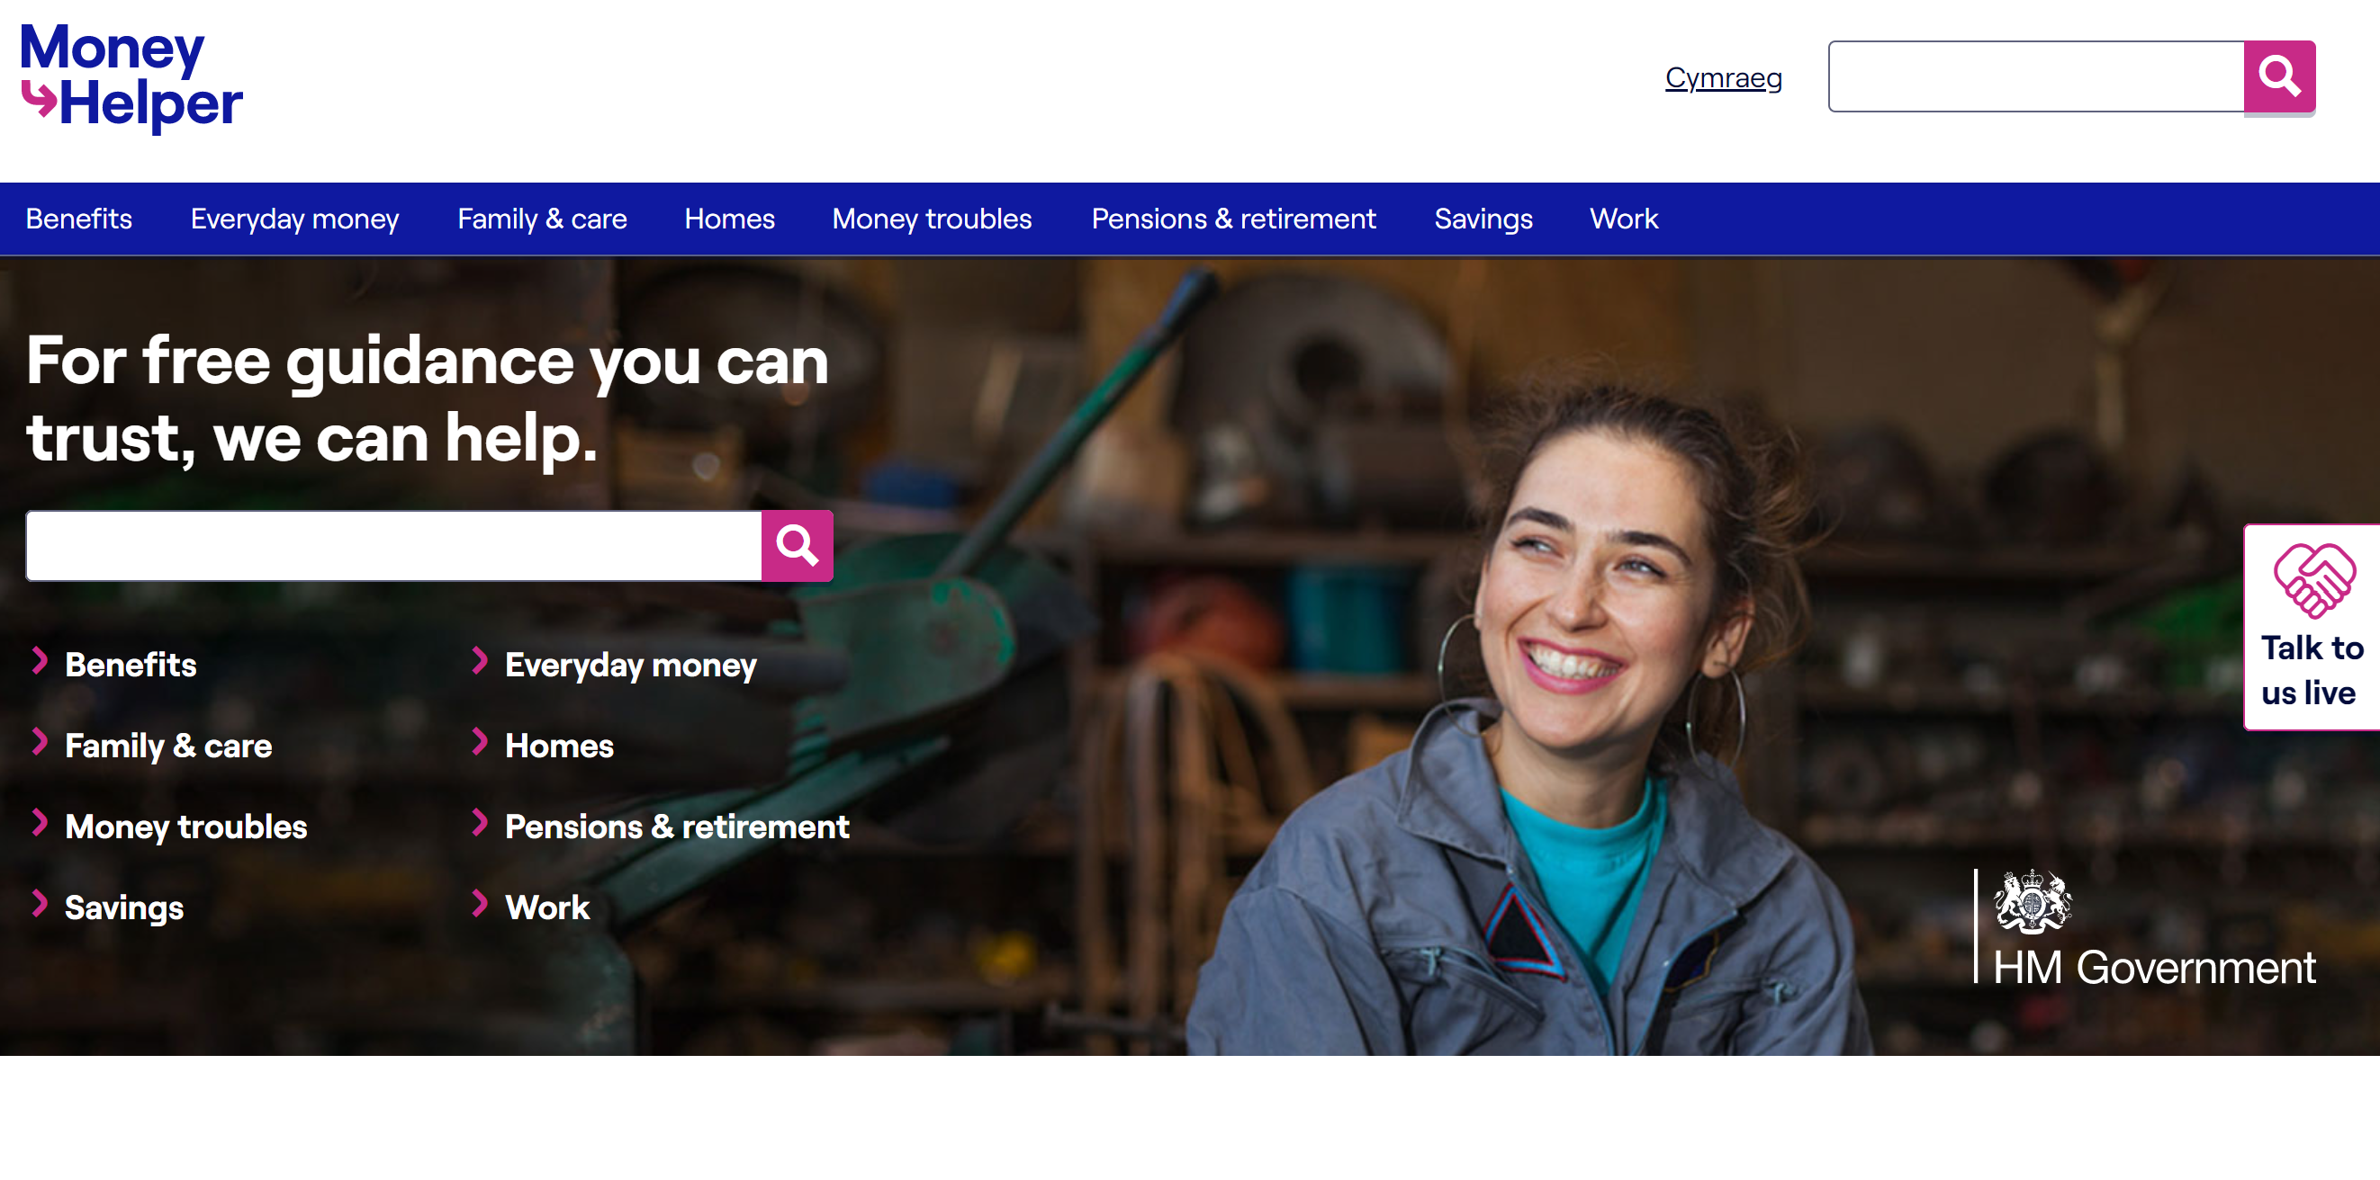
MoneyHelper website - introduction
https://www.moneyhelper.org.uk/en
Notes:
This is an example of how the website looks. You can see the various headings where you can look for more information and we will be looking at some of these in more depth as we go through the presentation. Under the money troubles heading you will find our cost of living campaign which looks like this

Slide 8




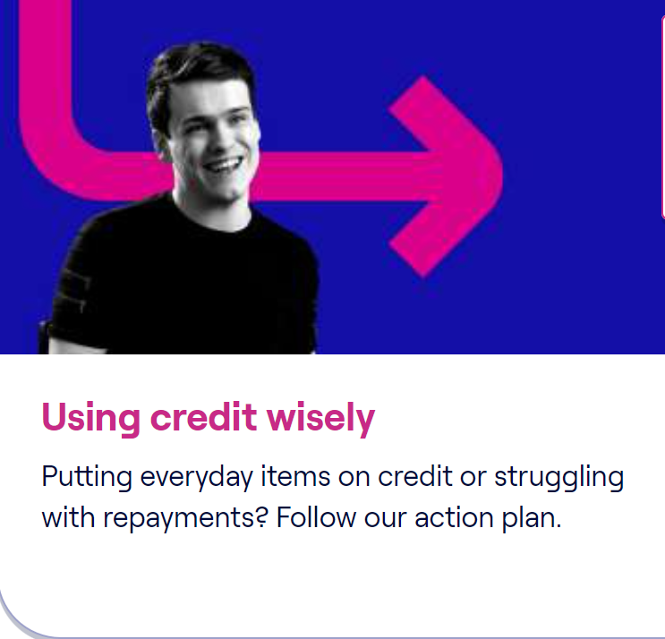

Cost of Living help, your questions answered
https://www.moneyhelper.org.uk/en/money-troubles/cost-of-living
Notes:
Here is our cost of living campaign. You can see the relevant headings that has lots of information and guidance for you to check out. There articles are also available in video format which is about 3-4 minutes long.

Slide 9

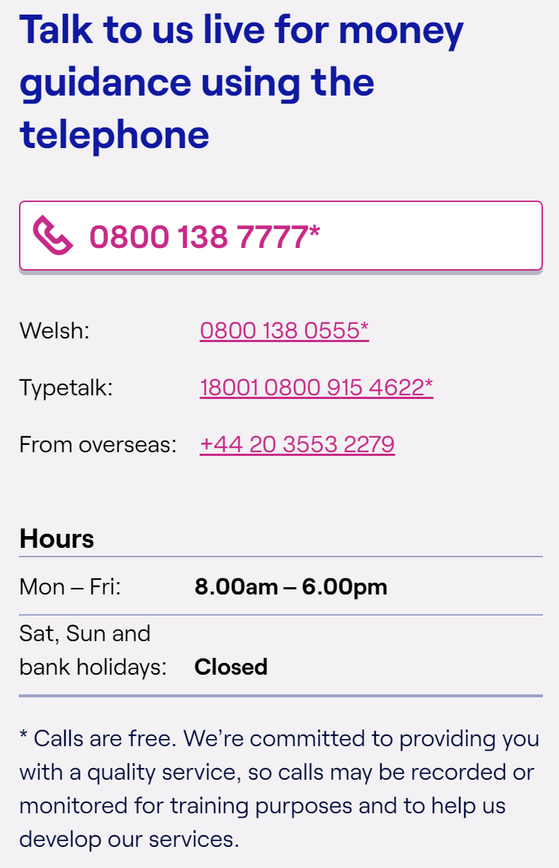

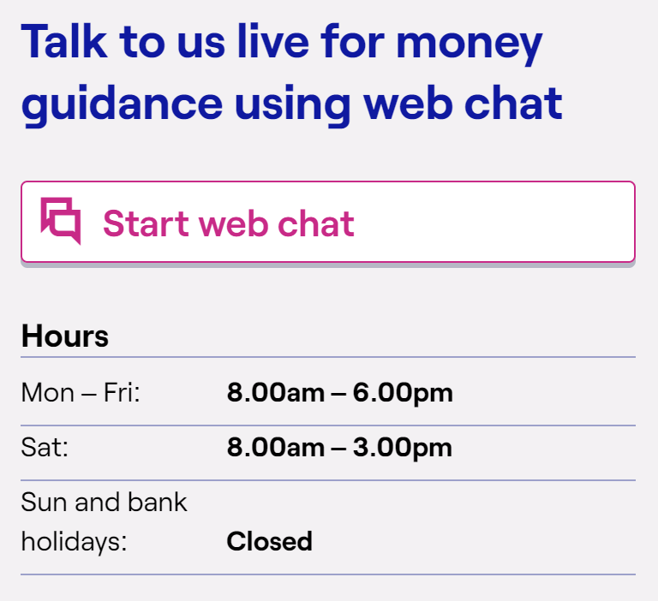
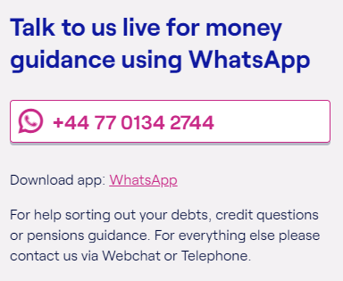
Money Guidance
Notes:
You can also access this guidance via phone, webchat or even whatsapp. Lines are open and chat is available Monday – Friday 10.00am – 6.00pm

Slide 10

Steps to Financial Wellbeing
    Taking control of your money
    Get the money you’re entitled to
    Plan for the unexpected
    Secure your future
Notes:
We are now going to look at 4 key steps to support financial well-being and some resources on Money Helper that can support these steps

Slide 11
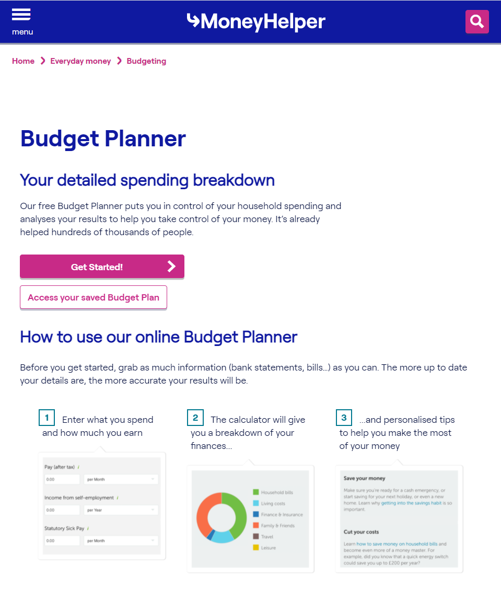


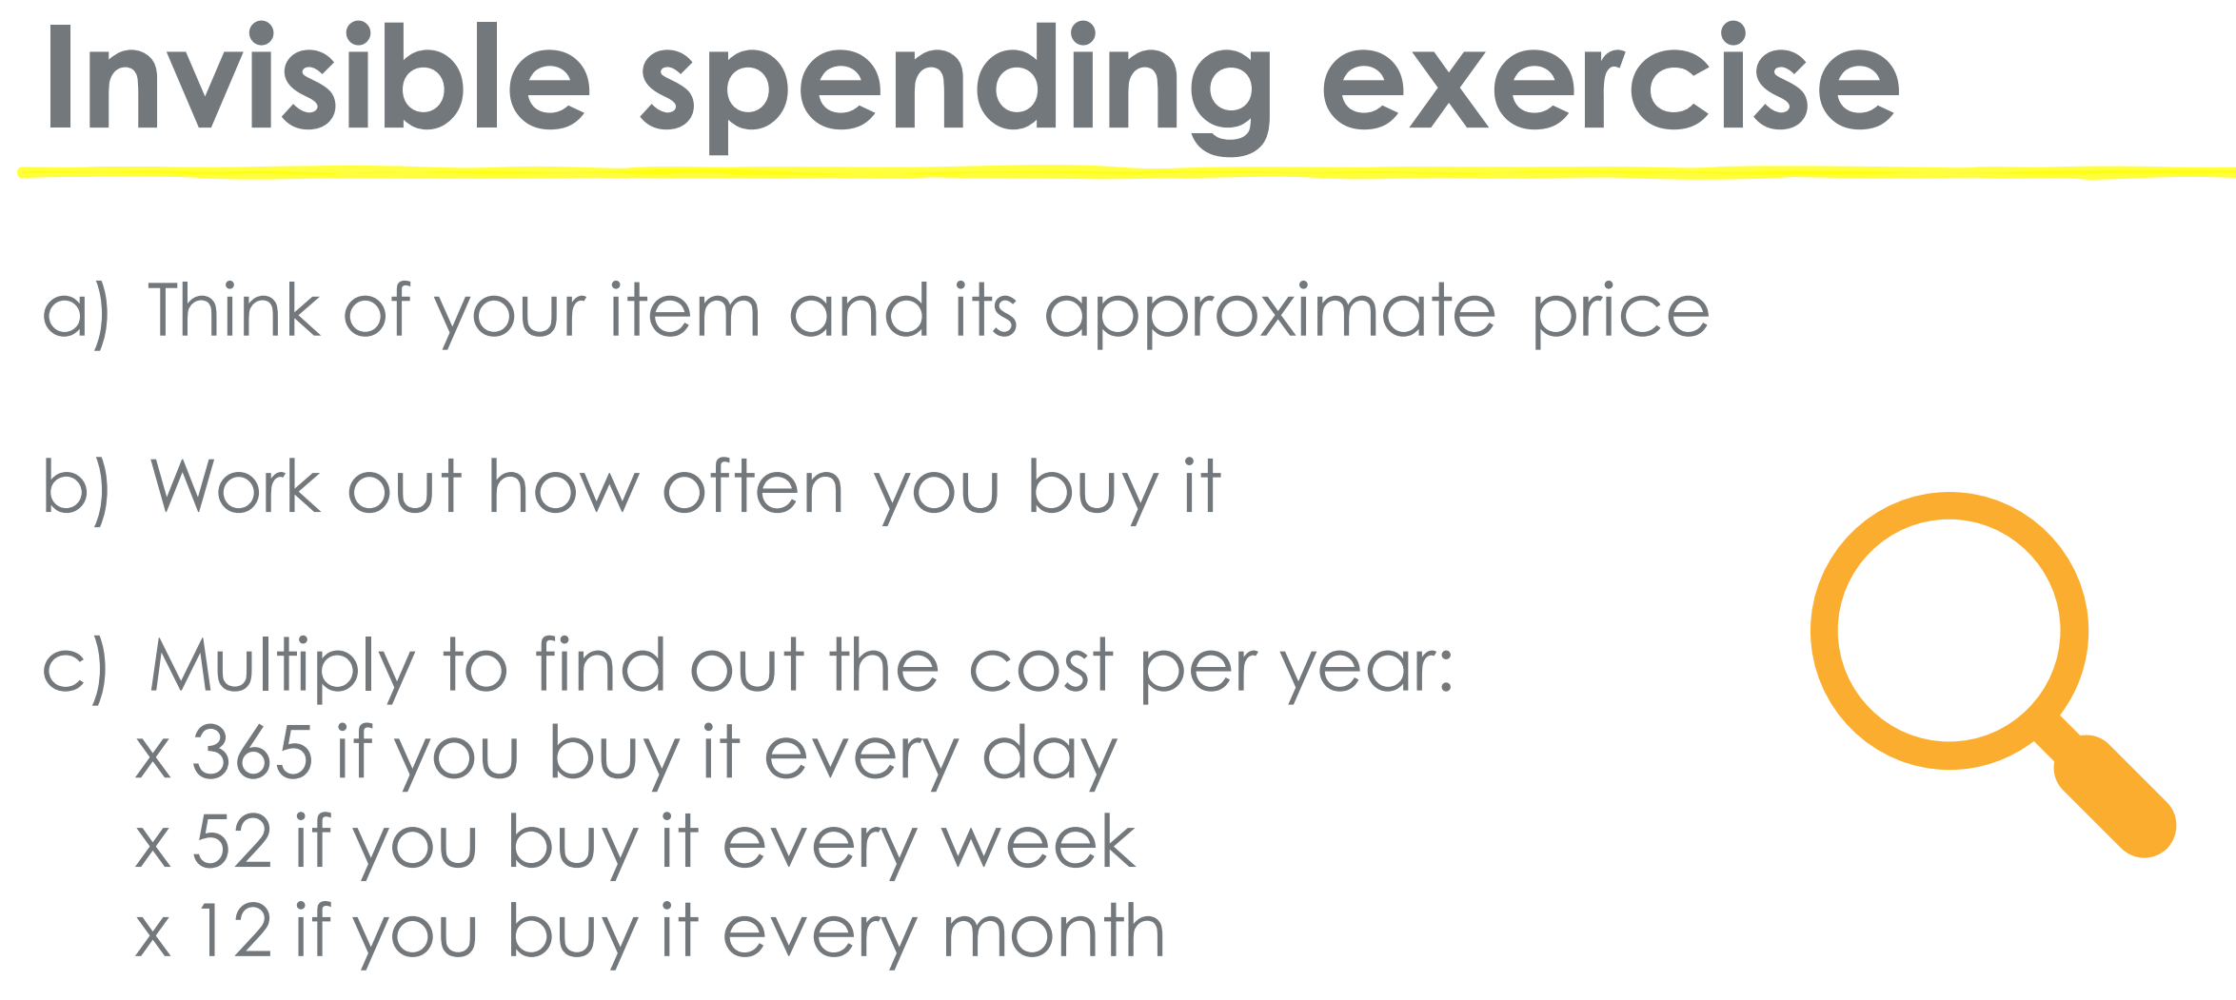
    1. Taking control of your money – Budget Planner
Tips
Don’t forget to budget for annual bills and things like holidays and gifting occasions
Use your bank statements to help check for regular bill payments
If you use cash a lot, try to record what you spend it on
Invest in me:
I will use 30 minutes of my time this week to do my household budget ….☺
https://www.moneyhelper.org.uk/en/everyday-money/budgeting/budget-planner
Notes:
The first golden rule of good money management is to understand how much money you have coming in vs how much money is going out. Over half of UK households keep a regular budget and most say it gives them peace of mind about how much they are spending and makes them feel better about life in general.
Money Helper has a free budget calculator which will help you to know exactly where your money is being spent.
Knowing how to manage a budget and keep track of where every pound is being spent, is a great first step to starting your savings, getting out of debt or even preparing for retirement.
The budget planner will give you a place to record all your spending, so you won’t forget anything and a breakdown of your finances by category.
It will even display it visually, so you could find much more of your budget it being taken up by unessecary items for example than you had realised!
The budget planner will also give you personalised tips when you’re all finished and you can also download and save your results.
As well as the budget planner you could also do the invisible spending exercise . Think of an item you buy regularly think of its approximate price, work out how often you buy it and multiply it to work out its cost per year. Here you could find out that your daily coffee is actually costing you hundreds if not thousands of pounds per year. You are now able to make a more informed choice of how spend your money.

Slide 12
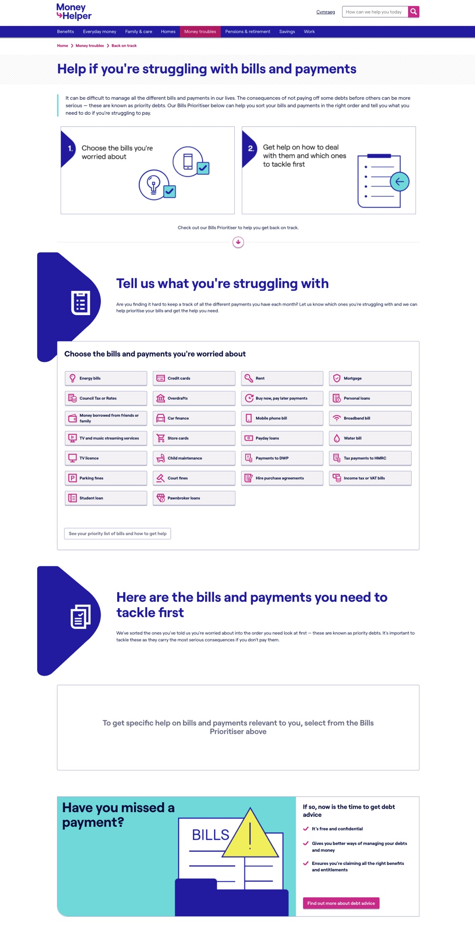
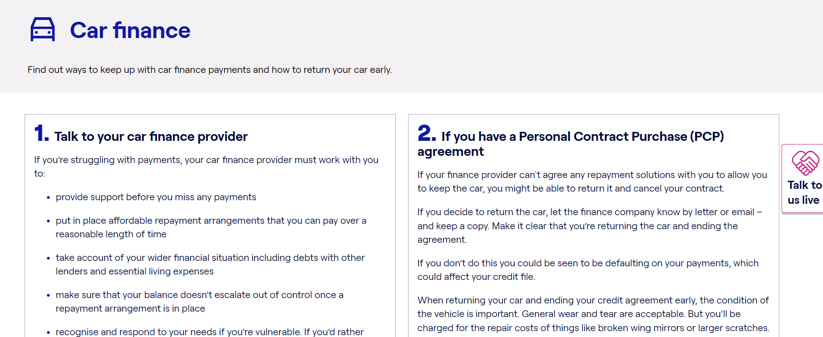



Bill prioritiser tool
Taking control of your money – Prioritise bills
In a couple steps this tool helps people prioritise and tackle bills and payments they might be struggling with. This is for people who are in a ‘pre-arrears’ space, and can help them avoid missing payments or route them to debt advice if they require it.
People select which bills or payments they are worried about.
They are provided with a prioritised list of bills to tackle first.
Visit the Bill prioritiser
PIGGY BANKING METHOD
Notes:
The next step to taking control is to prioritise your bills. It can be difficult to keep track of all the payments we need to make in our lives and often we can be unsure of which bills need to be paid as a priority.
Our bill prioritiser tool on money helper can help you prioritise and keep on track. This is designed for people who are worried about payments and just in that pre-arrears space and can help you to avoid missing payments.
The tool can help to put bills and payments in the right order, so for example if you are worried about paying your mortgage or your or your car finance, it will advise you that the mortgage is the priority, no matter how scary the letter from the car finance company may be. If via the prioritiser you identify that you’re struggling to pay – whether it’s your rent, your mobile phone bill or loan repayments – it will tell you in two easy steps what to do before you miss a payment and offer guidance on the types of things to say or ask for.
A great method to use to ring fence your spending is the piggy banking method. This is actually a method I use with my online banking…….it’s a great way to ensure you don’t overspend and miss those priority payments. You simply set up different accounts for different priorities. So you may have an account for direct debits to pay for those priority payments and one for spending. That way you can ensure that you never overspend on your direct debt account.

Slide 13
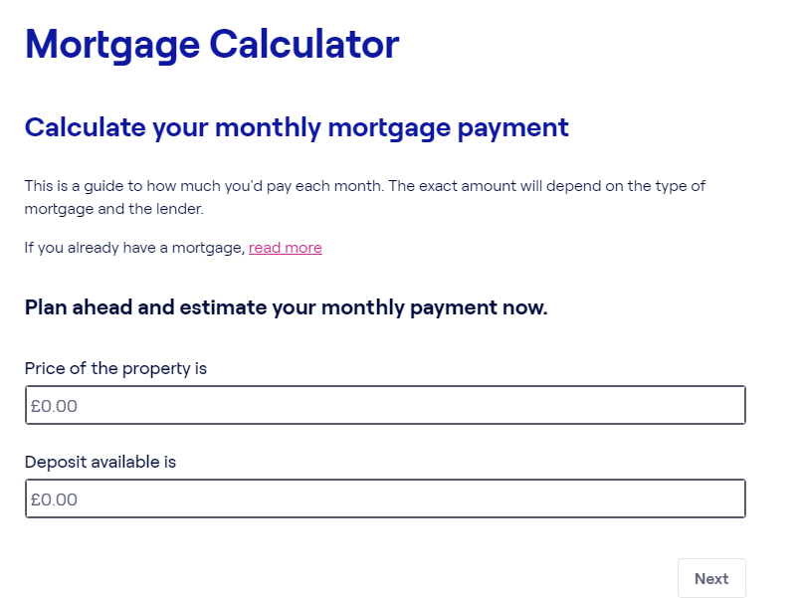


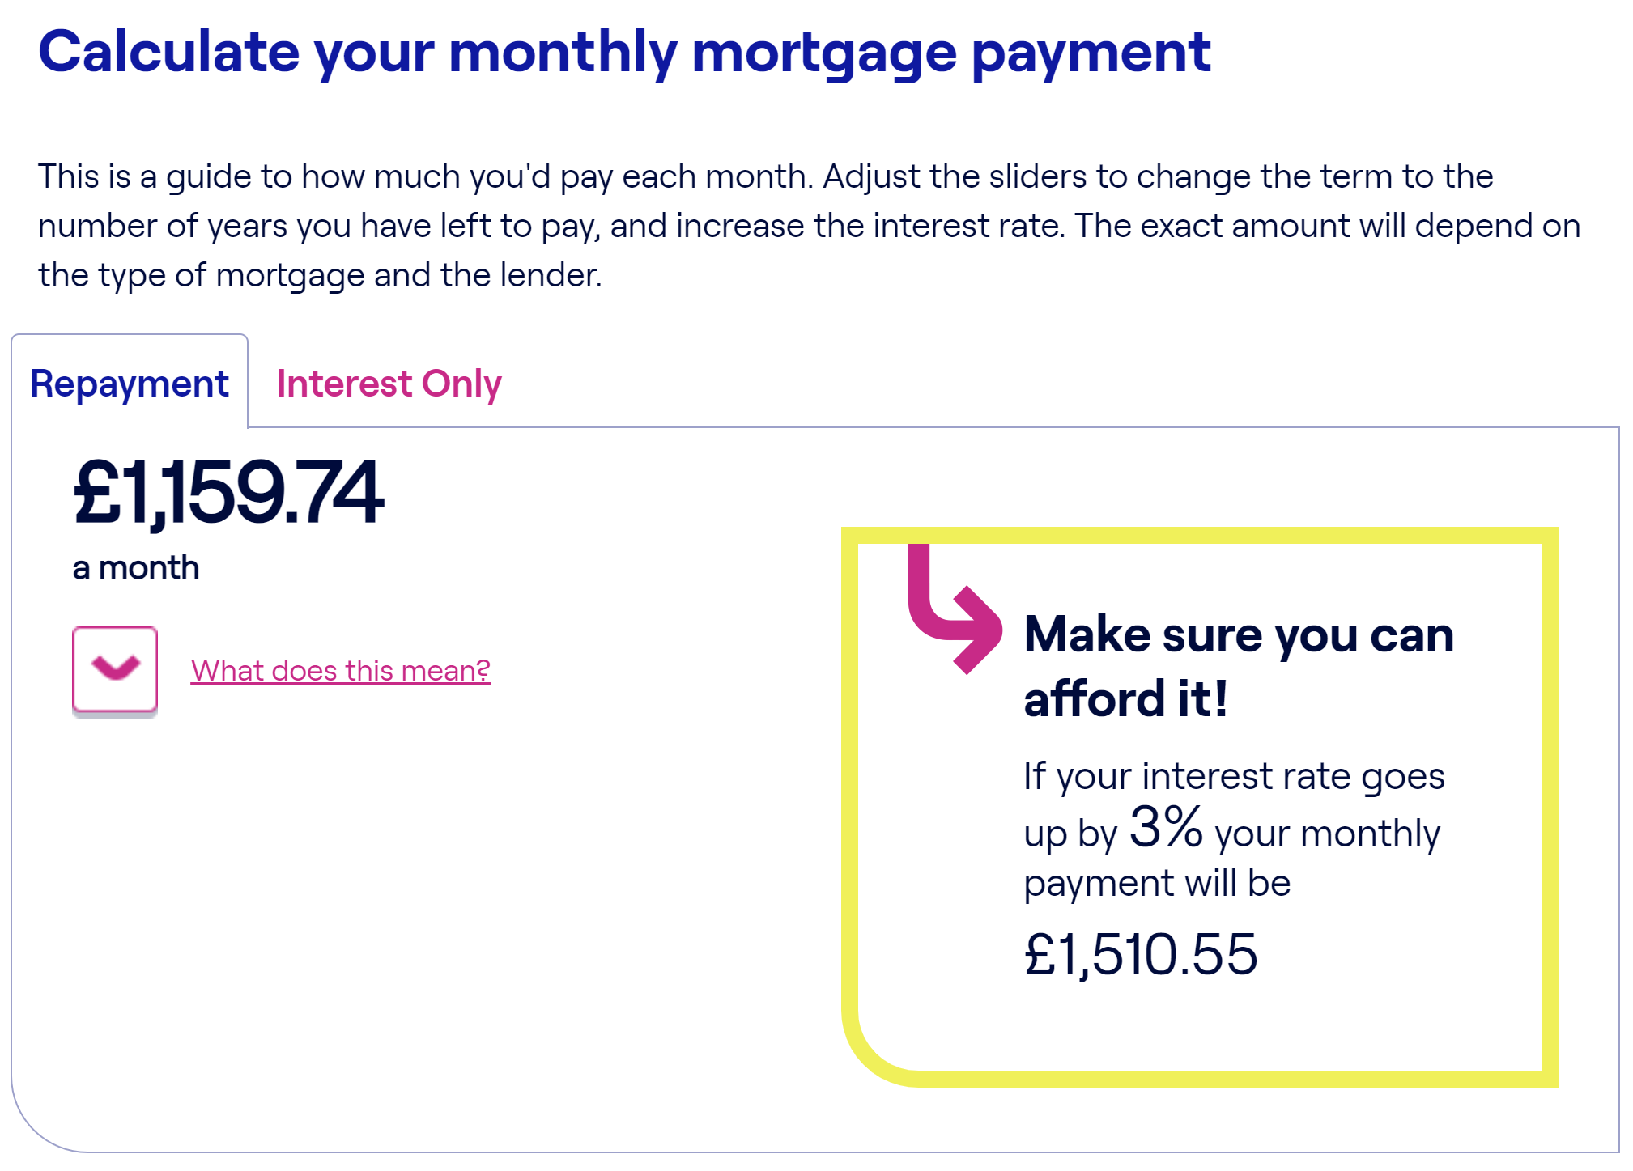
Mortgages
Notes:
There has been a lot in the press about the new mortgage interest rates rise.
When your mortgage rate will change depends on what type of mortgage you have.
The most used tool on Money Helper is our mortgage calculator and it can help you to understand how a new rate can affect you. Remember to always contact your mortgage company if you are worried. There are options available such as changing to interest only or increasing the term of your mortgage. Of course, you need to take your individual circumstances into account and speak to you mortgage company about what is available and what’s right for you.

Slide 14

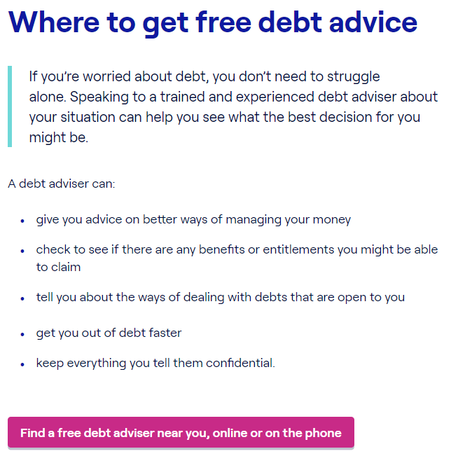

    Free Debt Advice
Tip
Don’t let your wellbeing suffer, most people who have received debt advice tell us they feel less stressed or anxious and more in control of their life again.
Seek advice sooner rather than later.
https://www.moneyhelper.org.uk/en/money-troubles/dealing-with-debt/debt-advice-locator
Notes:
I mentioned earlier we fund debt advice.
To put that into context, as an organisation we have invested £83 million on the provision of free debt advice for England. We know there are over 9 million people in the UK who are in debt. Research shows it can take people 1 -2 years to admit they have a problem and to seek out advice. We did some research into the barriers to people seeking debt advice and the most common barrier was shame and embarrassment.
Being in debt is nothing to feel embarrassed about. Its so easy to fall into that debt spiral – you spend more than you earn, you borrow to fill the gap then before you know it all of your income goes towards repaying debt and you have nothing left! If you are struggling with debt please speak to someone..
Free debt advice is available to you and can be transformative for people. Debt advice is Impartial and confidential, your employer will not be notified if you access advice so please don’t put your head in the sand, seek help. On the Money Helper website we have a debt adviser tool which will detail local services where you can get debt advice. You may also want to refer yourself into our Money Adviser Network whereby you can access free telephone or digital debt advice and receive a call back within as little as 30 seconds. I have put the links on the slide so you can access this when you get the slides. Please also do share this with family and friends

Slide 15
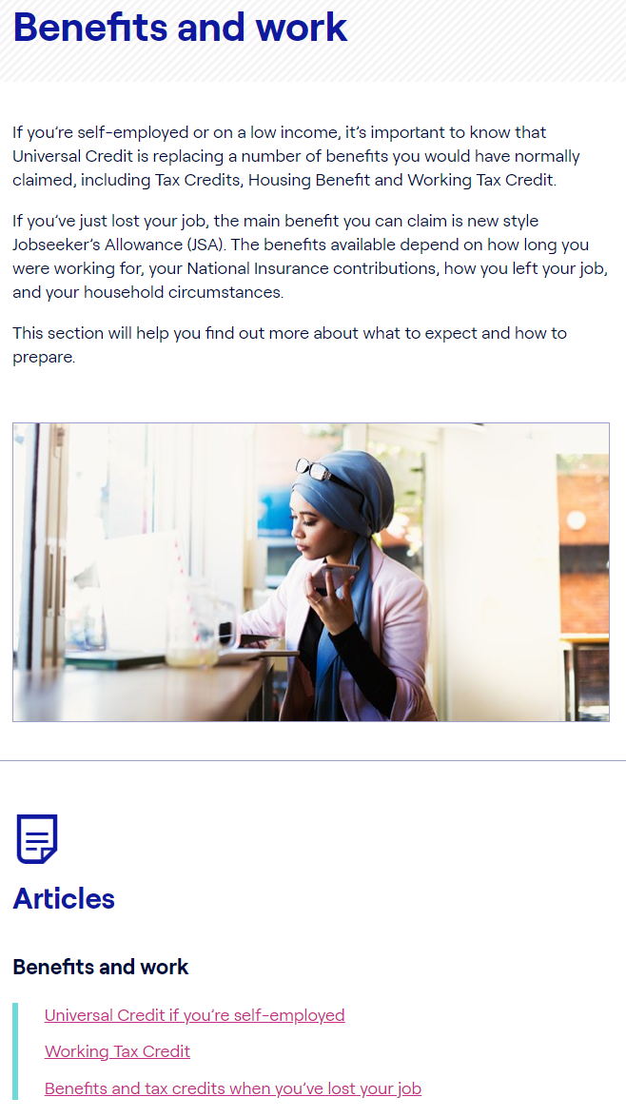
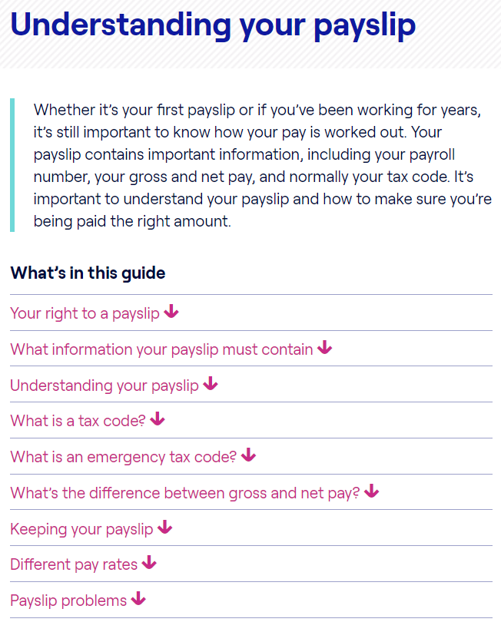
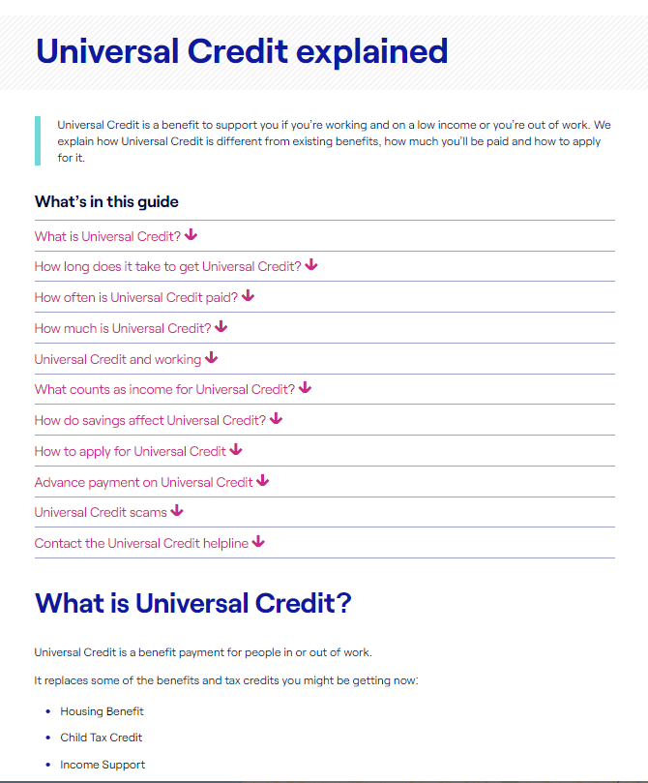
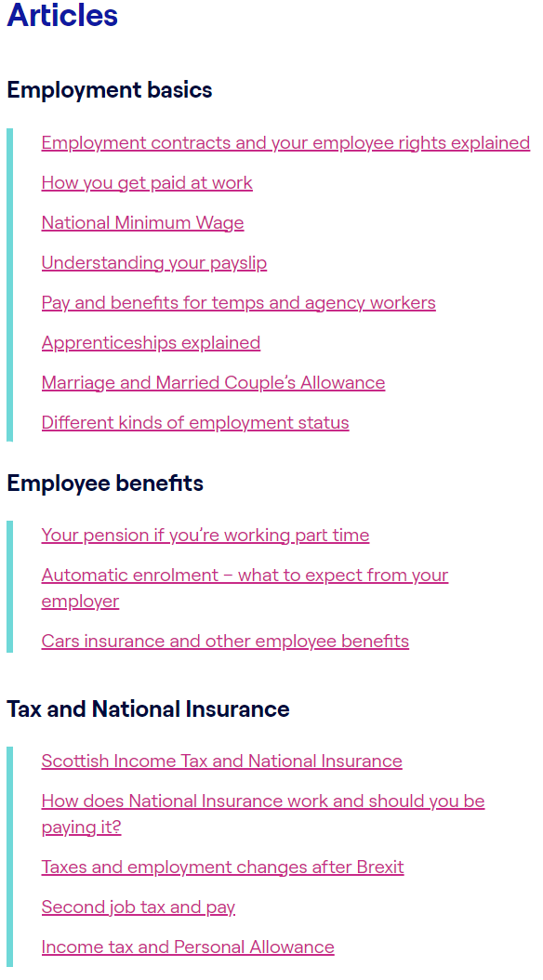
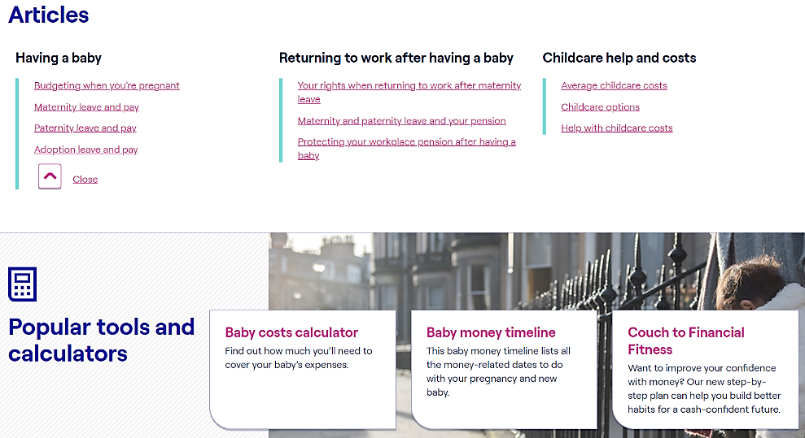
    2. Get the money you are entitled to
Make sure you’re being paid the right amount. Check your payslip and tax code
  www.moneyhelper.org.uk/understanding-your-payslip
Don’t miss out on help when it’s available — make sure you’re claiming all the benefits you’re entitled to
https://www.moneyhelper.org.uk/en/benefits/benefits-calculator
Having a baby or adopting? Find out what help is available
  www.moneyhelper.org.uk/baby-benefits
Childcare costs can take up a large chunk of your family’s income. Find out what help is available
  https://www.moneyhelper.org.uk/en/family-and-care/becoming-a-parent/help-with-childcare-costs
Notes:
A great way to Maximise income is to ensure you are receiving the money you are entitled to.
A good place to start is to ensure that your tax code is correct. We have section on Money Helper that helps you to understand your payslip and tax code. If you don’t understand parts of your payslip or think there might be a mistake, speak to someone in the payroll section of your company. Please also do follow the link when you get the slides for more hints and tips.
We also have a new benefits calculator. By answering four questions, you can get a quick estimate of what you might be entitled to from £17BN in unclaimed benefits and social tariffs. While it isn’t a guarantee of untapped income, the tool can uncover £100s if £1000s in unclaimed support.
One thing to remember is that people can qualify for in work benefits so its worth checking it out.
As I am sure you are aware children are expensive and you may be able to get help with certain costs or receive certain benefits. You should also know your rights in terms of maternity benefits and have a plan in place for your finances on maternity leave or if your partner is taking maternity or paternity leave.

Slide 16


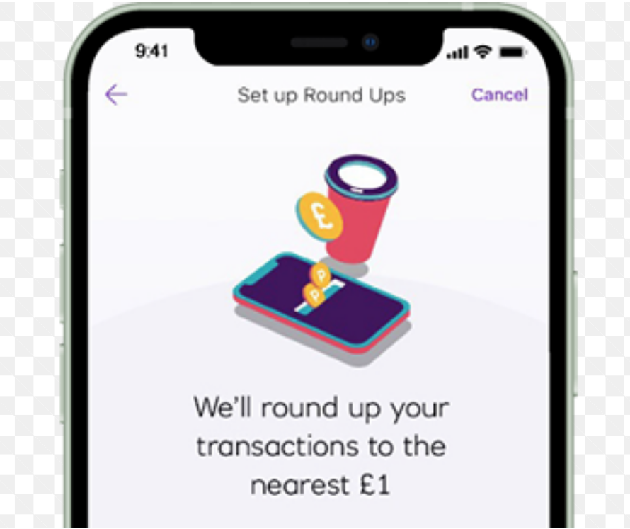
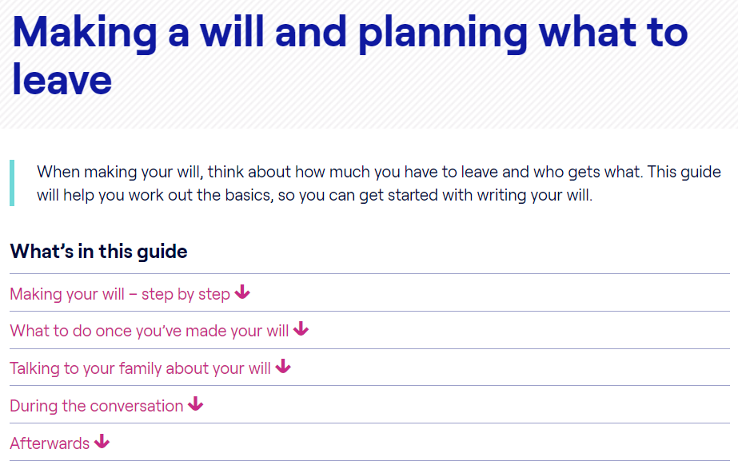
    3. Plan for the unexpected
Saving for the unexpected and emergencies
  This is often called ‘rainy day’ money. People save to make sure they have money available if something unexpected happens, like their car breaking down, a broken washing machine or boiler, or a bill that they hadn’t budgeted for
  https://www.moneyhelper.org.uk/en/savings/how-to-save/savings-calculator
Choose who will receive your pension savings in the event of your death
www.moneyhelper.org.uk/dependants-in-retirement
Find out why you should make a will and how to go about it www.moneyhelper.org.uk/making-a-will
Notes:
The one thing that makes people feel more financially confident is knowing they have savings behind them,
Our research shows that 21% of people in the South East of England wouldn’t be able to afford an unexpected bill of £300 or more.
An Emergency savings pot is a great way to build financial resilience and feel in control and confident.
If you want to start thinking about savings Money Helper has a great section of the website to tell you all about savings. There is also a savings calculator tool available. You can use it to work out how long it’ll take to save for something, if you know how much you can save regularly.
Or if you need something by a certain date, we can tell you how much you need to save regularly and how to keep your savings on track by giving you some helpful tips.
I’ve been terrible at savings but I’ve recently joined the round up on my banking app and I’ve already managed to save a few hundred pounds. If that’s not for you there are lots of other ways you can save, you could even try1p a day saving challenge.
Unfortunately, death can be an unexpected event in life and you should think about who will receive your pension in the event of death and also about making a will. A will sets out your wishes for your money and possessions on the event of your death. We have lots of information and guidance on Money Helper on how to do this.

Slide 17
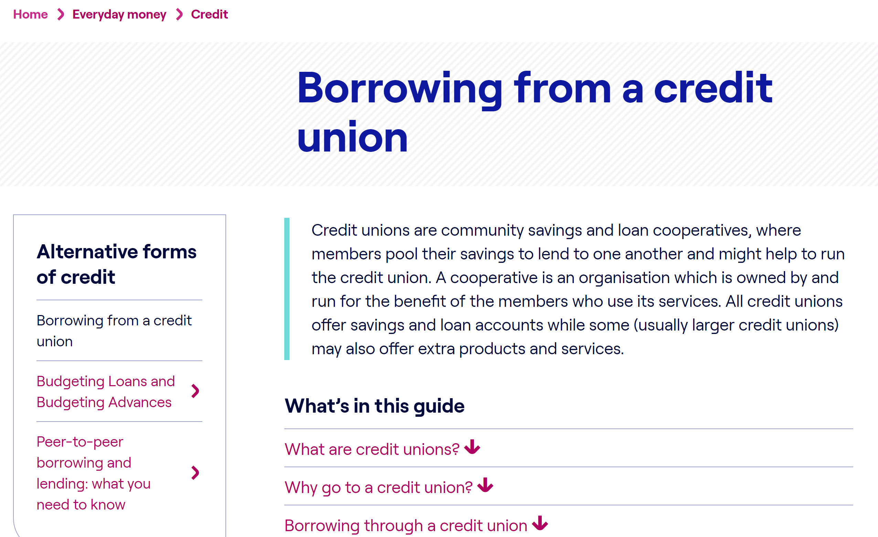

Credit Unions
https://www.findyourcreditunion.co.uk/
Notes:
If you don’t have any savings to fall back on and you decide you do need credit or a loan then you should consider seeking the assistance of a credit union.
Credit unions are community savings and loan cooperatives. A cooperative is an organisation which is owned by and run for the benefit of the members who use its services.
In England, there’s a cap on the amount of interest that credit unions can charge on their loans. There are no hidden charges with credit union loans and no penalties if you repay the loan early. As with any lender, you’ll be expected to repay your loan as agreed.
Credit unions are regulated in exactly the same way as the major banks, and they may also be able to offer you smaller loan amounts than the banks would and they can also offer financial wellbeing resources. Wave Community bank is the credit union we have partnered with today and will be telling you a little bit about themselves at the end.

Slide 18
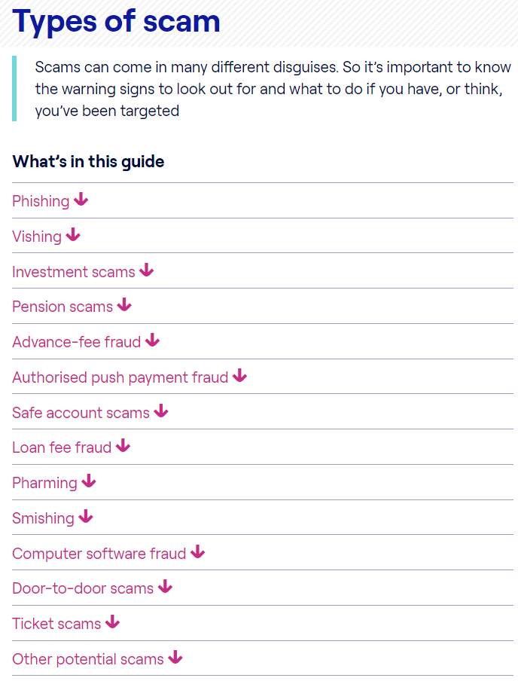
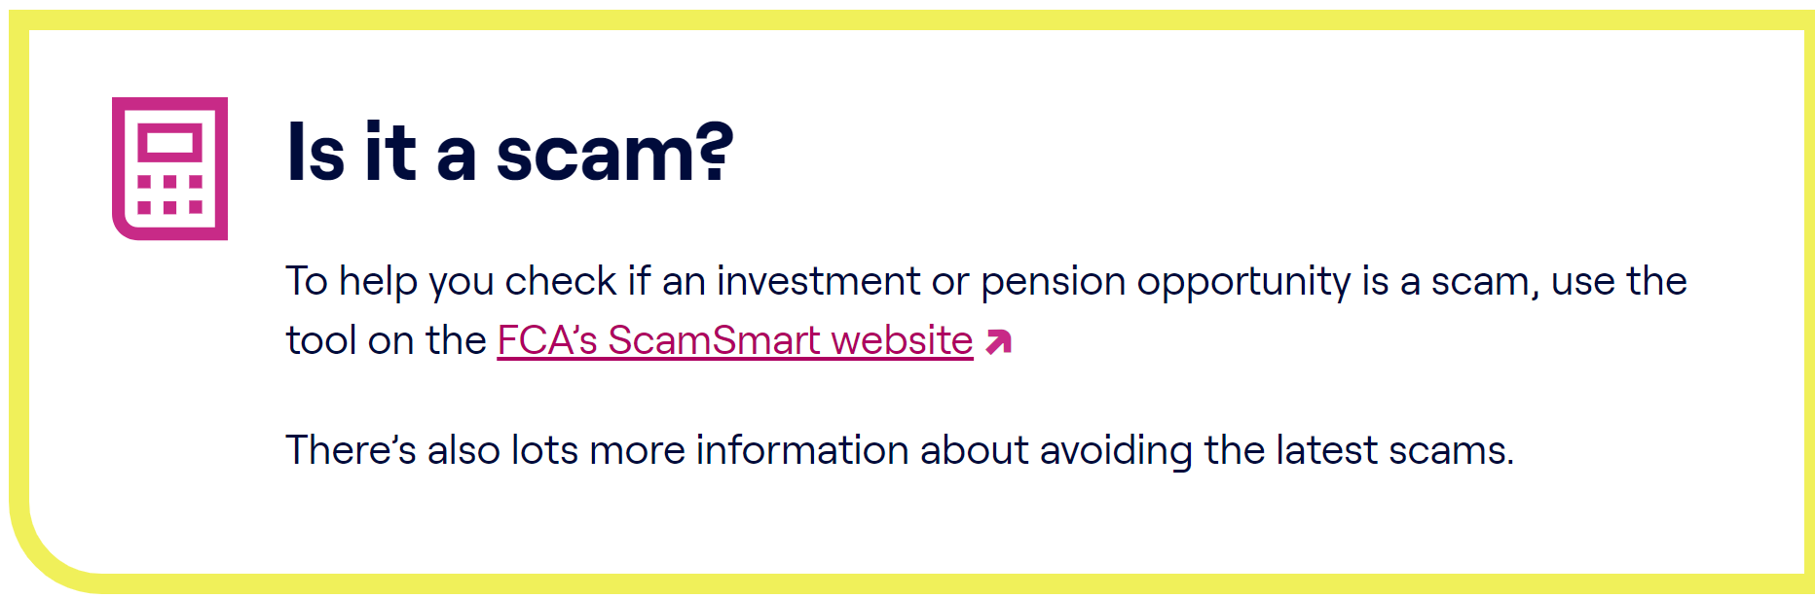
    Plan for the unexpected
Appoint someone you trust who can act on your behalf if
you become unable to manage your own affairs
  www.moneyhelper.org.uk/power-of-attorney
Ending a relationship can have financial consequences – knowing your options can ease the process and lower
the cost
  www.moneyhelper.org.uk/divorce-and-money-calculator
Scams come in all shapes and sizes. Learn how to spot
the signs and avoid losing your hard-earned money
  www.moneyhelper.org.uk/scams
Notes:
So continuing with unexpected life events, If you are unfortunate to be incapacitated and become unable to look after your own affairs, you may like to appoint a power of attorney and again we have links on to how to do this.
Relationship breakdowns often have financial consequences and we have a divorce and money calculator that can help you to understand what financial impact your divorce may have. Divorce can also have a very large impact on your pension and we have a dedicated helpline for this.
Unfortunately, scams are on the rise, with the introduction of AI it is becoming harder to spot scams. Money Helper can also help you understand the different ways you could be scammed, and how to recognise them so you're confident you can spot one and let friends and family know too. We've also got guidance, so that if the worst does happen, you'll know what to do next and who you need to contact to report a scam.
We have dedicated helpline for pensions and scams. The important thing to note is if it looks too good to be true it usually is, if someone you know contacts you out of the blue to request money always double check with that person and call them back.

Slide 19
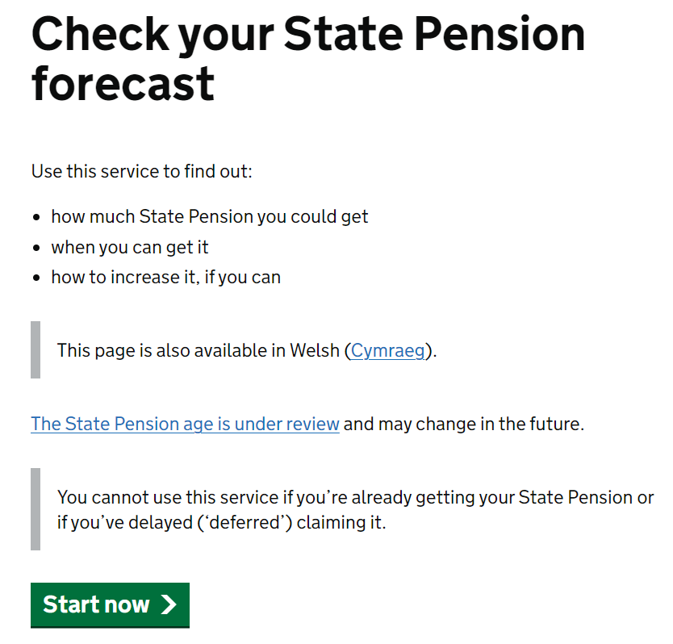
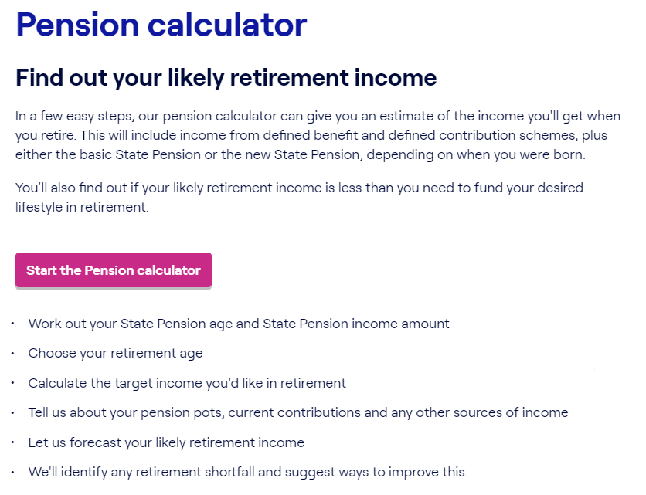
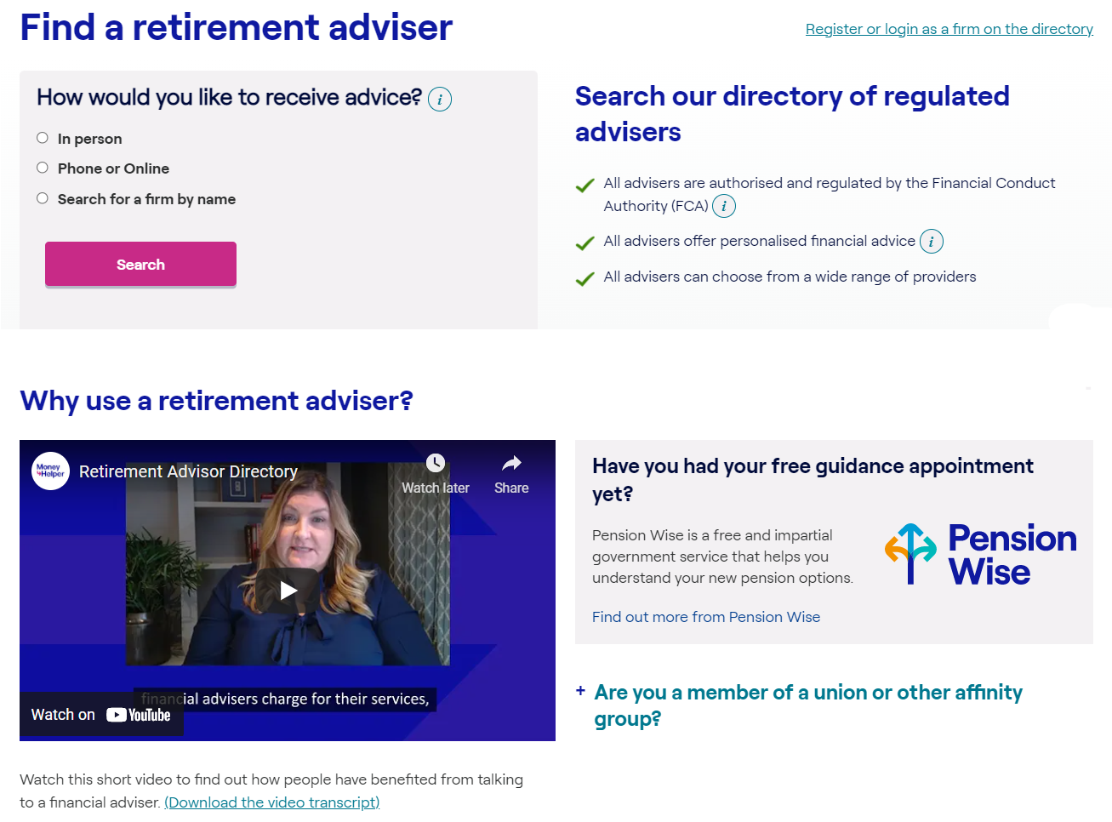
    4. Secure your future – Retirement Savings
Make sure you’re in a workplace pension
  https://www.moneyhelper.org.uk/en/pensions-and-retirement/pensions-basics
Check how much you’re saving and use our pension calculator to find out if it’s enough
  https://www.moneyhelper.org.uk/en/pensions-and-retirement/auto-enrolment/workplace-pension-calculator
Find out what your retirement options are, as well as traps to avoid. Book your Pension Wise appointment
  www.moneyhelper.org.uk/pensionwise
Sometimes we all need a professional to help us make the right choices. Find a regulated financial adviser to help with your planning
  https://www.moneyhelper.org.uk/en/pensions-and-retirement/taking-your-pension/find-a-retirement-adviser
Notes:
So now lets look at securing your future.
It is pension awareness week so today is a great time for me to emphasise that pensions or retirement savings are very important. In the South East 48% of people say they will not have enough to cover their expenses in retirement. The earlier you start the better. You are never too young to start saving for retirement!
You may have had more than one job and have accrued different pension pots. We helpful link to help you find lost pensions on money helper, you just need to know your National Insurance number and name of employer.
You can speak to our pensions team for general queries about pensions and we have dedicated lines for pensions scams, pensions and divorce and pensions if you are self employed. If you are lucky enough to reach age 50 and have a UK based defined benefits contribution pensions, you can have a free in depth appointment that talks you through the options of how to access your pension.

Slide 20

    Women and Pensions
Women typically have about half the pension pot that a man has at retirement
This is due to:
Gender pay gap (25% in women over 50)
Career breaks (no pension paid during unpaid maternity leave)
Part time work (75% of part time workers are women)
Work changes due to menopause
Women over 50 are twice as likely to provide unpaid care for others than men
Divorce increases the savings gap with women being more likely to waive rights to a partner’s pension and only 3% of people seeking financial advice as part of their divorce
Notes:
I would just like to make a little note about women and pensions.
Women tend to live longer than men and will therefore require more money in retirement.
By the time a woman reaches state pension age (currently 67), they will have average pension savings of £69,000. This is £136,000 less than the average man, who will have saved £205,000.
Some of the reasons for this gender pension gap could be due to……
I would like to encourage the women attending today to start looking into their pension and ensuring they will have enough for retirement. For any men on the call please encourage the women in your life to do the same.

Slide 21
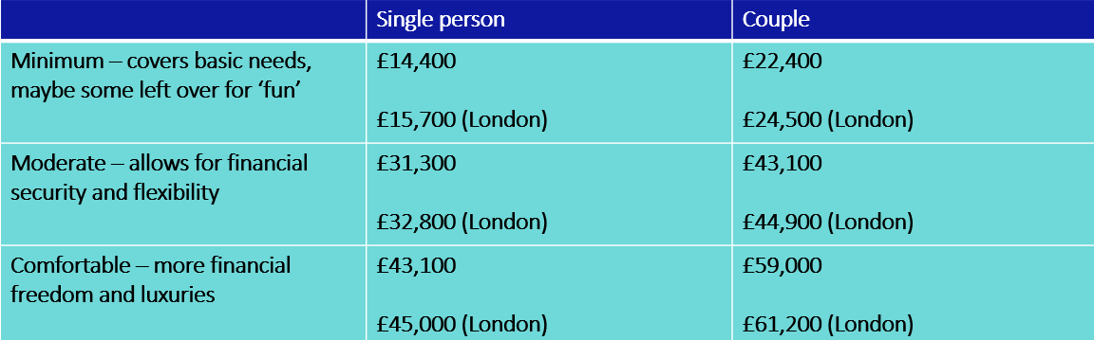
How much money do I need in retirement?
The answer to this question differs for everyone and will depend on their circumstances – especially if they still need to pay housing costs, and where they live. Research sets out three suggested levels of expenditure in retirement:
moneyhelper.org.uk/en/pensions-and-retirement/building-your-retirement-pot/check-the-progress-of-your-pension-and-retirement-savings
Read more here: retirementlivingstandards.org.uk/
Notes:
So you may be thinking how much will I actually need in retirement? We’ve given an indication of how much you will need based on your lifestyle, and a quick look at the figures on this table will show that if you live in London you will need more.
So the state pension currently gives you £221 per week which equates to £11,492 per year, so as you can see this does not even meet the minimum amount needed for retirement, you simply need to save more and the earlier the better.
Just a reminder here that there is a link on the money helper website which helps you check the progress of your pensions and calculate how much you will need to save for a comfortable retirement based on your circumstances.

Slide 22
What can you do now?
Trace lost pensions
Trace any lost pensions using the Government’s tracing service: gov.uk/find-pension-contact-details
State Pension
Get a State Pension forecast: gov.uk/check-state-pension
Nominate beneficiaries
Make sure your death benefit nominations are up-to-date for your current and any previous pensions
Calculate
Use our pension calculator to see what you’re on track to get when you retire and consider whether you want to pay more into your pension to increase your benefits
Budget
Use our helpful budget planner to keep track of your spending now and in retirement
Call us
MoneyHelper 0800 011 3797 if you have any questions or just want to have a chat about your situation
Notes:
So when it comes to retirement what can you do now? Here are some ideas
The best thing to do is to shift your mindset to including your pension when you think about your finances. So you probably think about your direct debits, current account, rent and savings regularly. Your pension should also be in those thoughts and you should be checking its progress regularly.

Slide 23

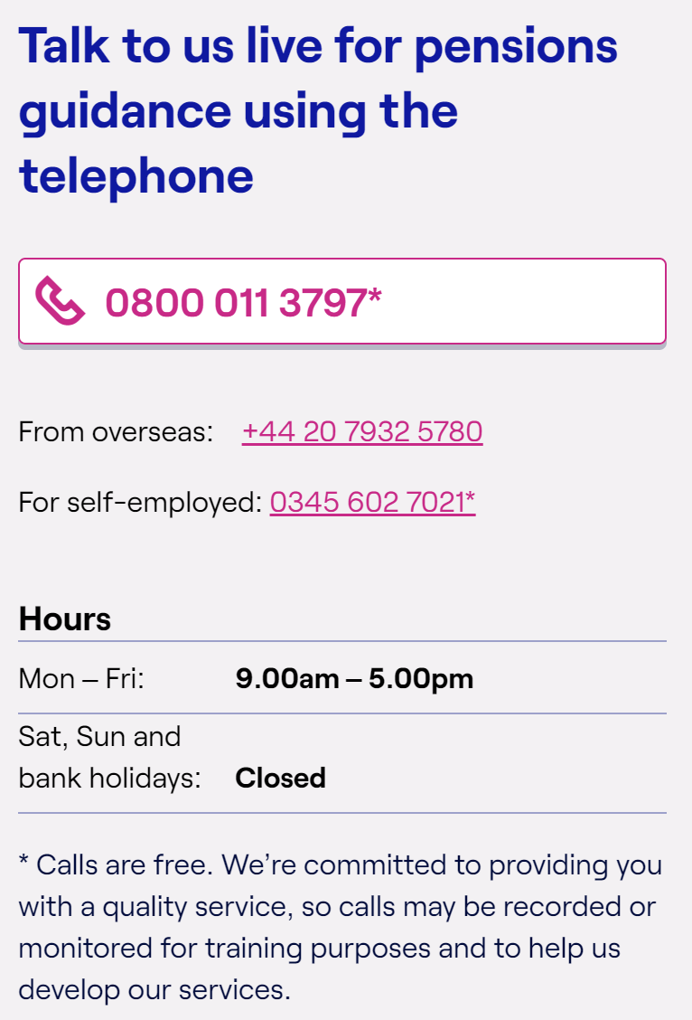
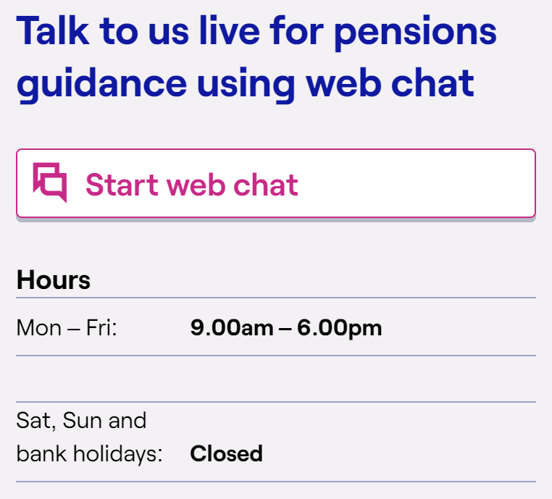
Pensions Guidance
Notes:
These are our numbers for the pension guidance. If it looks as though you would benefit from advice, which is a regulated activity and usually incurs a cost, we can we can point you in the right direction of an independent financial adviser

Slide 24
Summary Steps to Financial Wellbeing
    Taking control of your money (Prioritise bills, piggy bank, emergency savings)
    Get the money you’re entitled to (Being paid correctly, Benefits calculator)
    Plan for the unexpected (Death, divorce, scams)
    Secure your future (Save for the long term, save for retirement)
Notes:
We are now going to look at 4 key steps to support financial well-being

Slide 25
Thank you…….Questions?
Links to Questions
Check your NI contributions ; https://www.gov.uk/check-national-insurance-record
Pensions and redundancy : https://www.moneyhelper.org.uk/en/work/losing-your-job/your-pension-options-if-you-re-made-redundant
Pension if you have lived or worked abroad : https://www.gov.uk/new-state-pension/living-and-working-overseas
Help to save ; https://www.moneyhelper.org.uk/en/savings/types-of-savings/help-to-save-explained
Pension Tracing tool ; https://www.gov.uk/find-pension-contact-details
Pensions dashboard programme ; https://www.gov.uk/government/news/pensions-dashboards-coming-soon-to-a-screen-near-you
Local Credit Union Finder ; https://www.findyourcreditunion.co.uk/

